Slide 1
Assignment 1 Unit 3 Digital Portfolio

Slide 2
The audience and purpose of my portfolio
The target audience for My Portfolio are future employees, universities or apprenticeships who are interested in someone with my IT skills and knowledge, or any other skills I might be learning in future courses, or any other qualifications I might have, or achieve in the future.
The purpose of planning and designing this portfolio is to know how long it will take to finish and what steps need to be taken to complete the project. Also, it can help to produce a better portfolio by planning out the functionality and design of it before it is created. Producing a plan for My Portfolio will make it easier to create because I would have already written out what needs to be done for each step and my navigation charts and storyboards will of course already have given me an idea of what I'm making so I'll spend less time fine tuning the design.
The purpose of this portfolio is to display my skills and qualifications to future employers, universities or apprenticeships. And to make it easier for them to contact me.

Slide 3
Project plan and timeline
The creation of this portfolio should take roughly 5 weeks as shown below.
5. Check the functionality and design of it and make final alterations and design choices for optimization of color schemes.
2. Design and create a detailed navigation chart and storyboard with color schemes and font types.
3. Start coding up a rough of the website with the correct functionalities and looks.
4. Review design and tweak color schemes and positioning, as well as fix bugs.
6. Upload My Portfolio to the Internet.
1. Collect assets and create an asset table.
Week 1
Week 2
Week 3
Week 4
Week 5

Slide 4


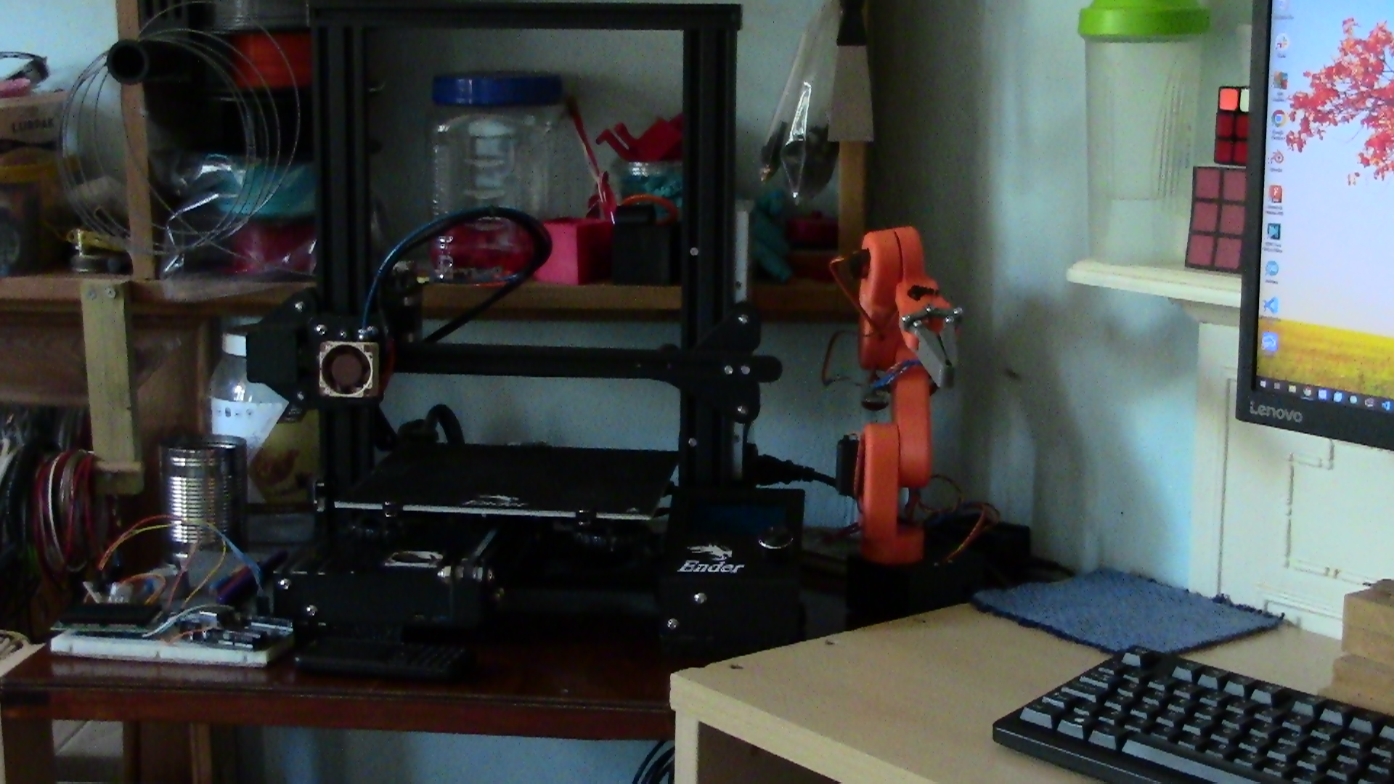
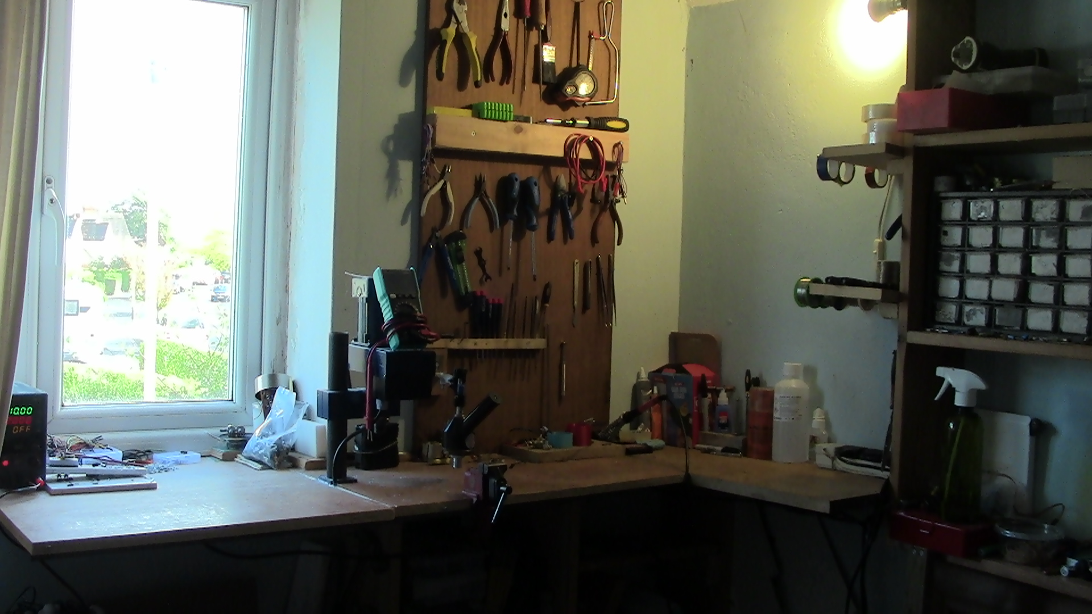
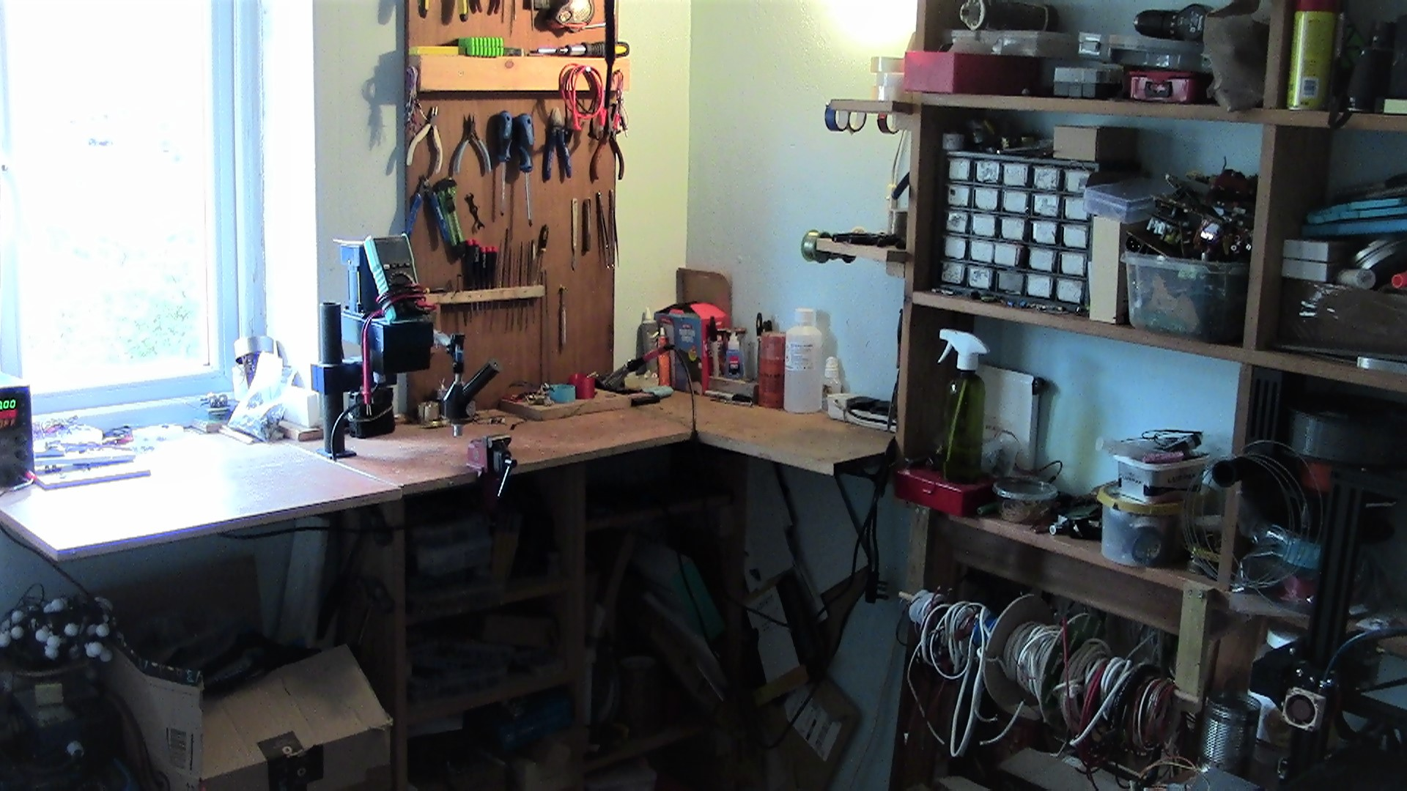
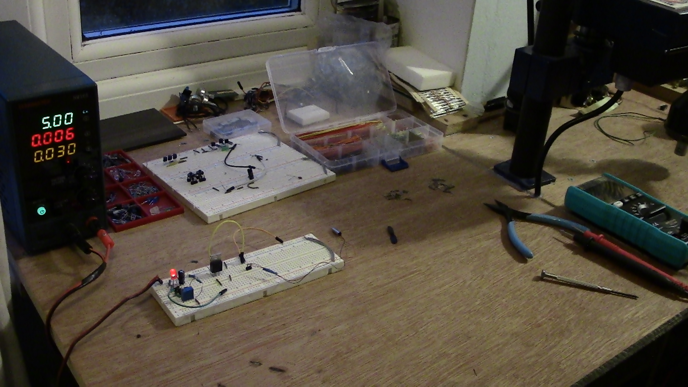
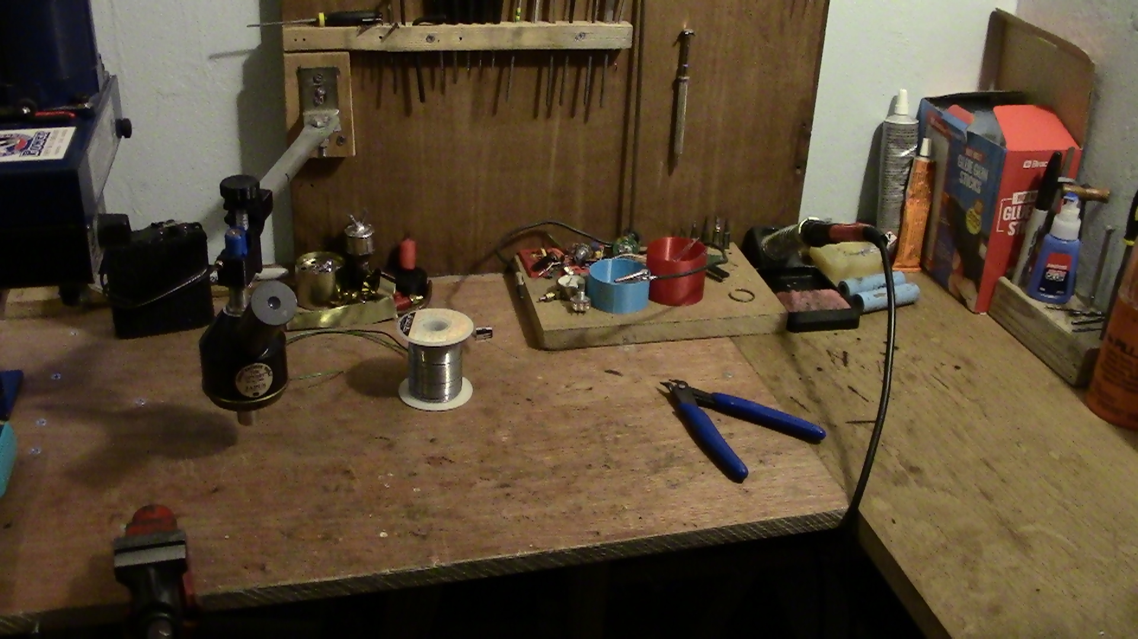
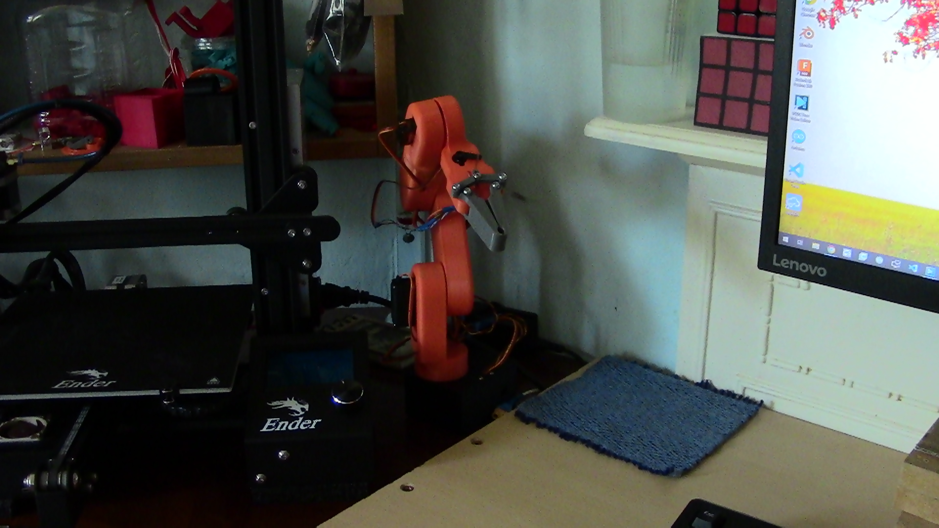
My asset table
Date of creation/access | Image/asset | File format | Where it is saved/sourced | URL | Size | Copyrighted?
14/1/23 |  | PNG | Link And OneDrive | Link | 70.3 KB | NO
14/123 |  | PNG | Link And OneDrive | Link | 44.1 KB | NO
7/10/22 |  | JPG | OneDrive | NA | 635 KB | NO
7/10/22 |  | JPG | OneDrive | NA | 583KB | NO
7/10/22 |  | JPG | OneDrive | NA | 381KB | NO
9/10/22 |  | JPG | OneDrive | NA | 731KB | NO
9/10/22 |  | JPG | OneDrive | NA | 666KB | NO
7/10/22 |  | JPG | OneDrive | NA | 537KB | NO

Slide 5
Navigation chart
Home
The reasons I have chosen this navigation chart and why I have designed it like this is because it is hard to get lost in it and it is easy to follow and understand. By having an entire course per page, it makes it easier to add future qualifications by merely creating a new page for the course and putting in all the details.
Course work
About me
Contact me
Course work
About me
Contact me
Home
Home
Home
L2 computing
Future curses
Unit 1 Unit 2 Unit 3 Unit 8 Unit 13 Unit 14-15 Unit 17
Back
Assignment 1
Assignment 1
Assignment 1
Assignment 1
Assignment 1
Assignment 1
Assignment 1
Assignment 2
Assignment 2
Assignment 2
Assignment 2
Assignment 2
Assignment 2
Assignment 2

Slide 6
My storyboard
Home page
Qualifications
About me
Contact me
Here I will introduce myself and talk about My Portfolio and about me.
The reason I've chosen this layout is because it is clear and simple. The colors match and it's pleasant to look at and things are well aligned. The design is not muddled or confusing and by having the correct fonts and sizes and colors for the text it is clear to read, understand and navigate.
In this textbox I will also use bold black text as used here and white text on the buttons on the Grey bar which would be bold as well. The font at the top displaying the page will be a similar white font and large so it's easy to see.
Image
Here I will have an image that is relevant from my asset table.

Slide 7
Qualifications
Home
L2 computing
Future courses
Here I would talk about my qualifications skills and courses that I have done and any other relevant information to do with my qualifications.
The reason I've chosen to have a button for each course or qualification is because it makes it easier to display the information from each course and it gets less confusing not having an endless list of qualifications.
Image
Here I will have a relevant image to do with my qualifications and courses

Slide 8
L2 computing
Back
Image
Hey I will display an image related to my course oh of an assignment or some other work I might have done.
I will display my coursework including assignments or anything else that could be relevant. I will have it scrollable so you can scroll through each unit. I've made it clear and easy to use by only having one simple button to go back to another qualification that a user might want to look at.

Slide 9
About me
Home
Image
Here I'll display an image of something about me or a project which I'll talk about in the textbox.
On this page I'll talk about myself, and my skills. I will have it scrollable so I can display projects I have done and in text boxes like these I will talk about projects and how I made them to show what I'm capable of for anybody looking at My Portfolio.

Slide 10
Contact me
Home
Image
Here I will select a relevant image that matches the color scheme and the rest of My Portfolio.
Here I will have details for contacting me and possibly links or e-mail addresses for employers or apprenticeships who might be interested in my skills.

Slide 11
What not to do
An alternate version of a storyboard which I have not chosen.
Home page
Qualifications
About me
Why I have not chosen this storyboard.
Why I have not chosen this storyboard.
it's because the colors don't match and it can be very hard to read yellow words on a white background or white words on a yellow background, also having it so bright it can be quiet overwhelming and it doesn't look very professional.
The bar with the buttons to the other pages also doesn't look good due to its dull color and the font doesn't show up very well making it harder to use for people with bad vision.
This is why I chose the storyboards above because they are easy to understand and clear on what it's saying as well as not being glaring or unpleasant to look at.
Also, this design has no image only colors and text which can be quite boring and dull and will not be as exciting or impressive for people viewing My Portfolio.

Slide 12
What not to do
An alternate design which I've discarded due to reasons stated above
Qualifications
Home
The text in this box is very hard to read because of the bad color choices and font size.
On this mood board, that I've discarded I would make it scrollable to display all my units and any other qualifications because of the navigation chart which I've also discarded below.
The reason I have discarded this option is because it would become a very long and confusing page which would make it harder for the users of the website, to see my qualifications due to the endless list.

Slide 13
Discarded navigation chart
The reason I haven't chosen this navigation chart is because it makes it harder to add future qualifications by having it all on one page. The page would become very long and confusing because it would have all my future courses as well that's why I chose to have a different page for each course like on the navigation chart above.
Home
Contact me
Qualifications
About me
Qualifications
Unit 1 Unit 2 Unit 3 Unit 8 Unit 13 Unit 14-15 Unit 17
About me
Home
Home
Assignment 1
Assignment 1
Assignment 1
Assignment 1
Assignment 1
Assignment 1
Assignment 1
Assignment 2
Assignment 2
Assignment 2
Assignment 2
Assignment 2
Assignment 2
Assignment 2

Slide 14
My explanation for design choices
I have chosen to have a separate page for contacting me, learn about me and know my qualifications. Having a separate page for each qualification makes it clearer to find them. Having buttons to all the pages at the top makes it clear to see and to navigate.
I have chosen blue and grey colour scheme because it has a nice contrast and with white text on buttons and the top bar it is easy to see everything. The reason I have chosen to put an image in is because the page will be very bland with just plain colours so it makes it more interesting for the viewer.
Design justification
The design solution that I have chosen fulfils its stated purpose by being easy for viewers to see my skills, qualifications and to contact me if they are interested in employing me.
The colour and text work well because it isn't glaring or hard to read and it's not boring or dull by having a turquoise header at the top. The clear separation to the rest of the page with the grey bar helps visually.

